Slide 1

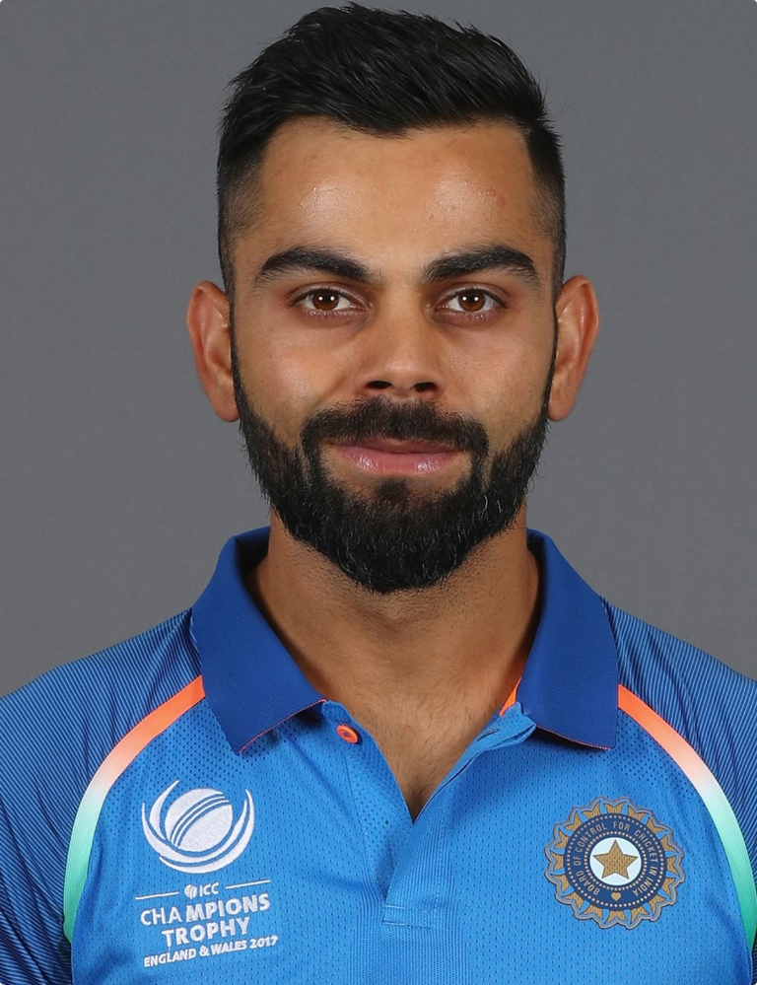

Virat Kohli: A Cricketing Legend
This presentation explores the journey, achievements, and impact of Virat Kohli, one of the most celebrated cricketers of our time.
by Manthan Bohra

Slide 2

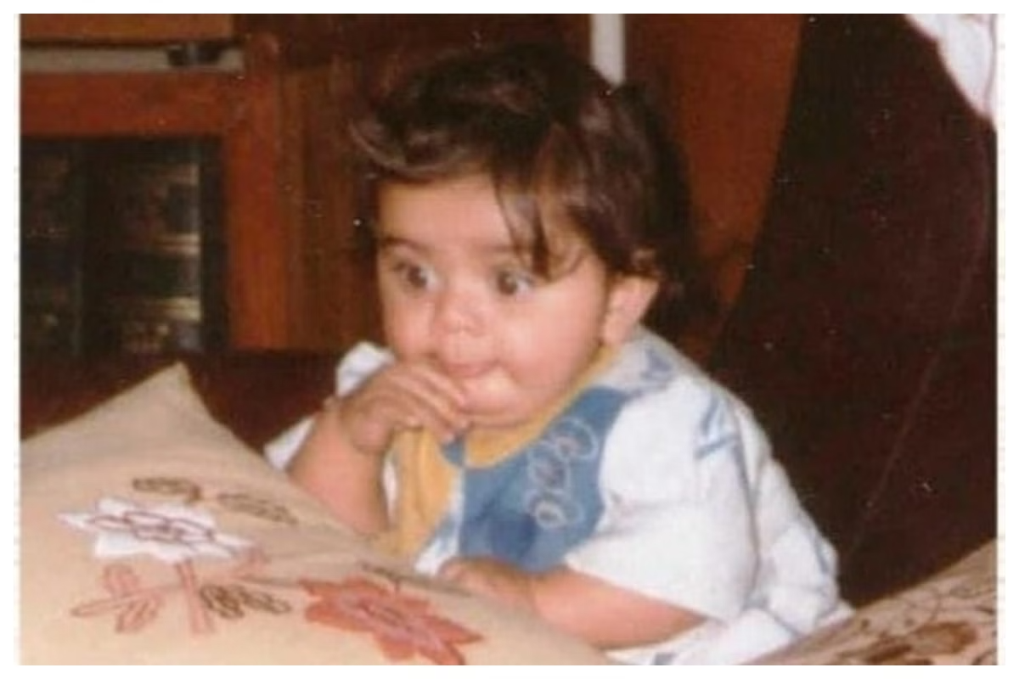
Early Life and Background
1
Date of Birth
November 5, 1988
2
Birthplace
Delhi, India
3
Family
Son of Prem and Saroj Kohli; younger brother, Vikas Kohli
4
Early Interest
Cricket from a young age, joined West Delhi Cricket Academy at 9

Slide 3

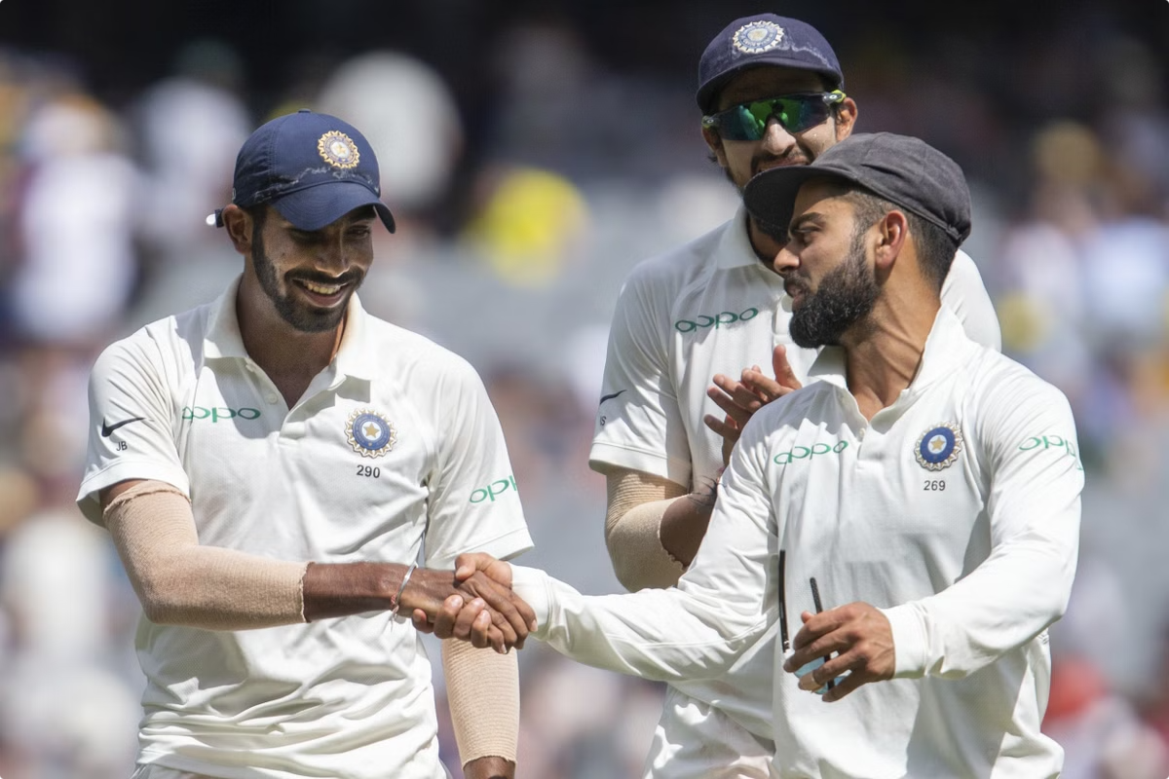
Domestic Cricket Career
1
Debut
Made first-class debut for Delhi in 2006
2
Performance
Notable innings in domestic games earned him recognition
3
Key Achievement
Scored 90 runs in a one-day game against Karnataka in 2006

Slide 4


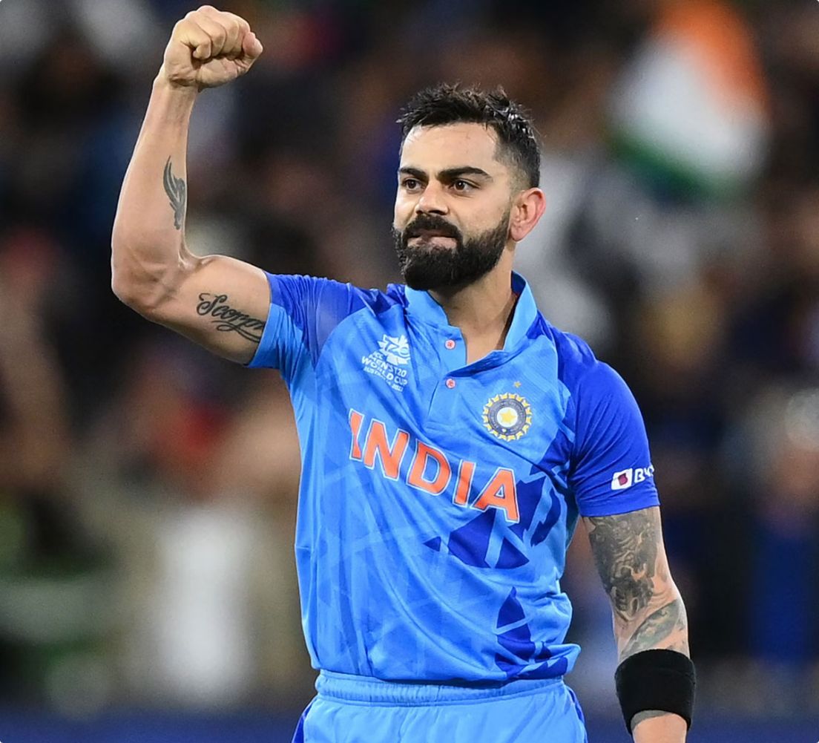


International Debut
ODI Debut
August 18, 2008, against Sri Lanka
Test Debut
June 19, 2008, against the West Indies
Initial Impact
Quickly established himself as a promising talent

Slide 5

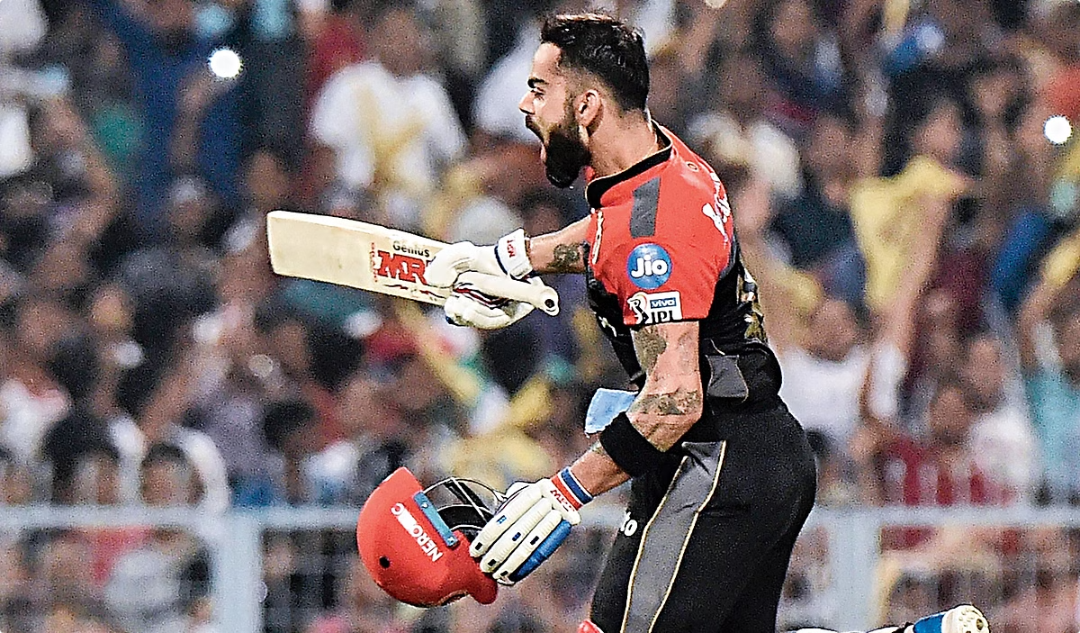
Career Achievements
Records
Awards
Fastest to 8,000, 9,000, 10,000, 11,000, 12,000 ODI runs
ICC ODI Player of the Year (2012)
Most centuries in a calendar year (ODI and Test)
ICC Test Player of the Year (2018)
Numerous Player of the Match awards

Slide 6
Captaincy and Leadership
T20 Captain
ODI Captain
Test Captain
Took over from MS Dhoni in 2017
Became captain in 2017, leading the team to several series wins
Held Test captaincy from 2014 to 2021, known for aggressive and dynamic leadership

Slide 7


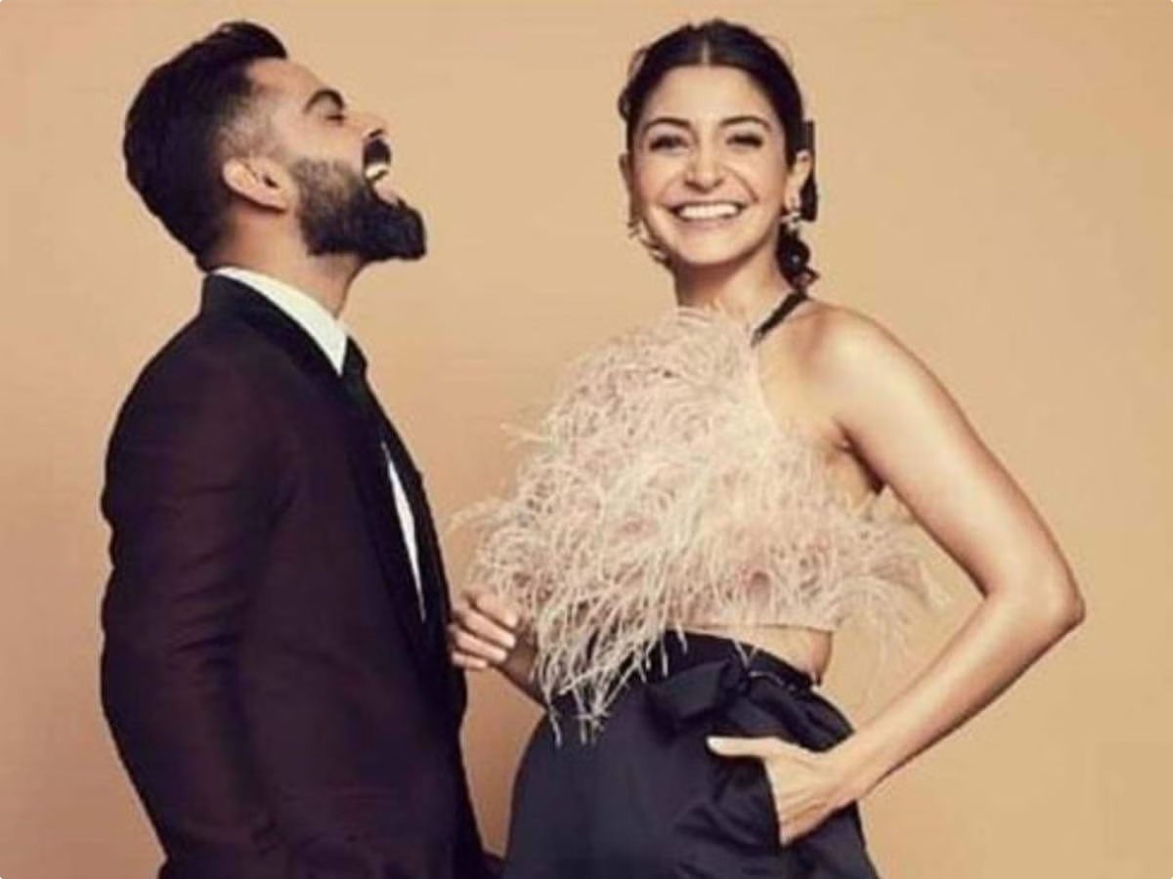


Off the Field
Marriage
Married Bollywood actress Anushka Sharma in December 2017
Philanthropy
Established the Virat Kohli Foundation to support underprivileged children
Lifestyle
Known for his fitness regimen and healthy lifestyle choices

Slide 8

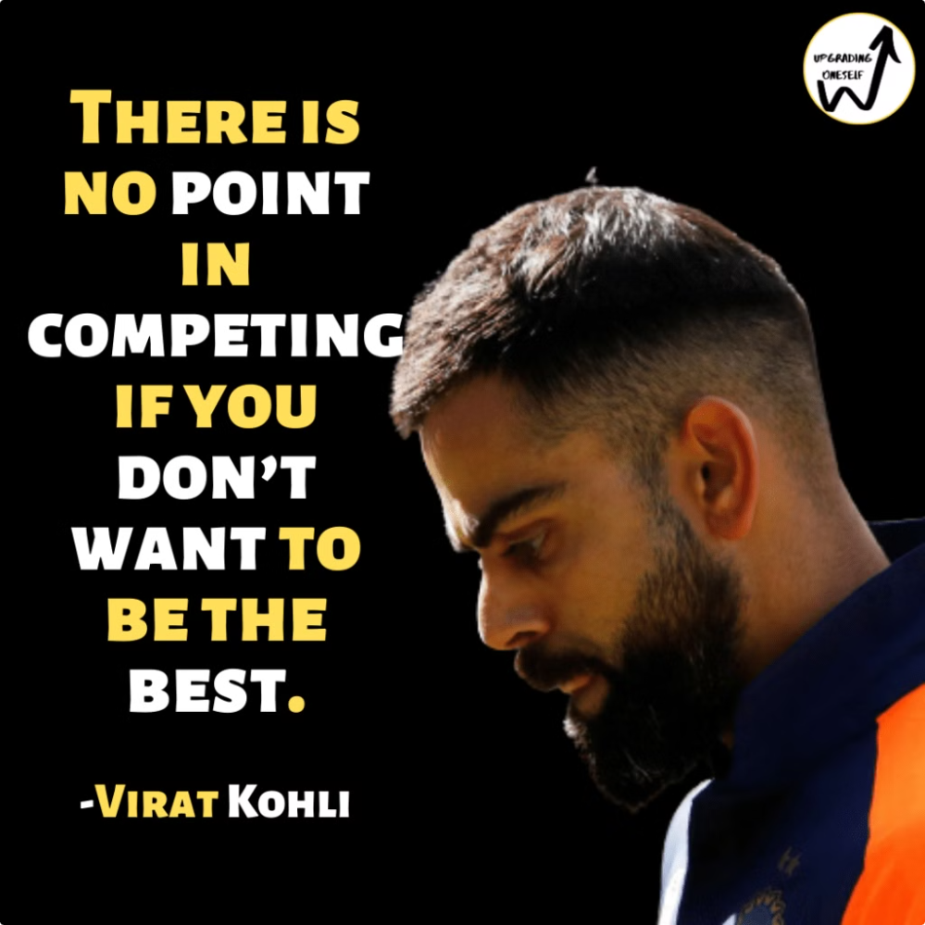
Legacy and Impact
Influence
Regarded as one of the greatest batsmen of his generation
Impact on Cricket
Pioneered new fitness standards and aggressive batting techniques
Inspiration
Continues to inspire young cricketers worldwide

